Slide 1

Events Proposal
Mastering the Art of Memorable Events.

Slide 2
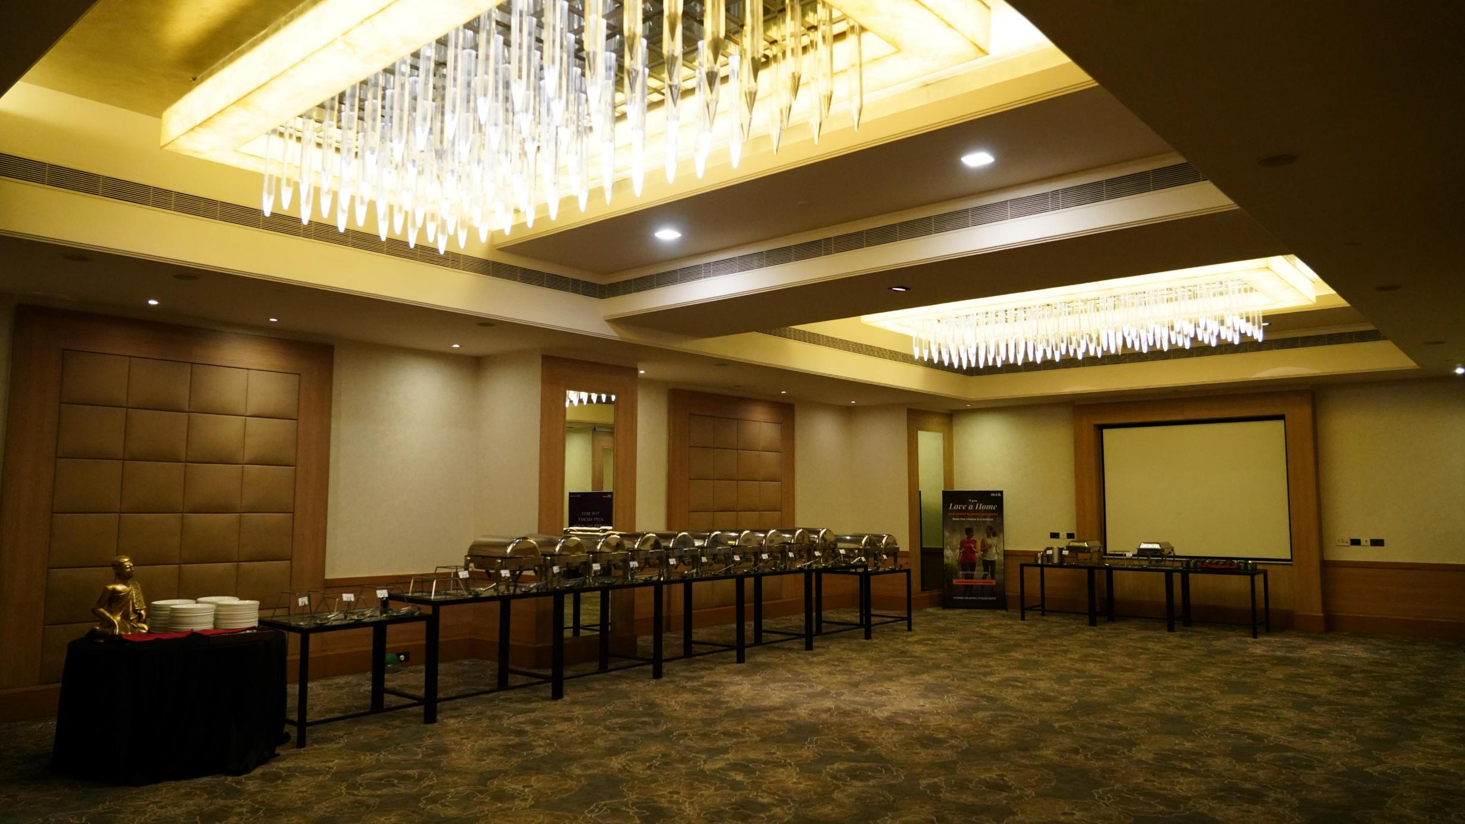
Unleashing the Brand Spirit
Majestic Matrix Marketing

Slide 3
But Who We Are ??
Our company specializes in a diverse range of services, tailored to suit the unique needs of each client. We mean it when we say that with our expertise you can be rest assured about the quality and creativity in your events, it will always reach optimum level.

Slide 4









Trusted By
Leading Brands For
Event Conceptualization & Design
Bar Setup & Beverage Catering
Stall Fabrication & On-site Activations
Product Launches
Dealer & Customer Engagement Meets
Rewards & Recognition Events
Retail & Outlet Branding
Market Activations & Promotions
Workshops & Educational Seminars
Festive & Cultural Event Activations

Slide 5
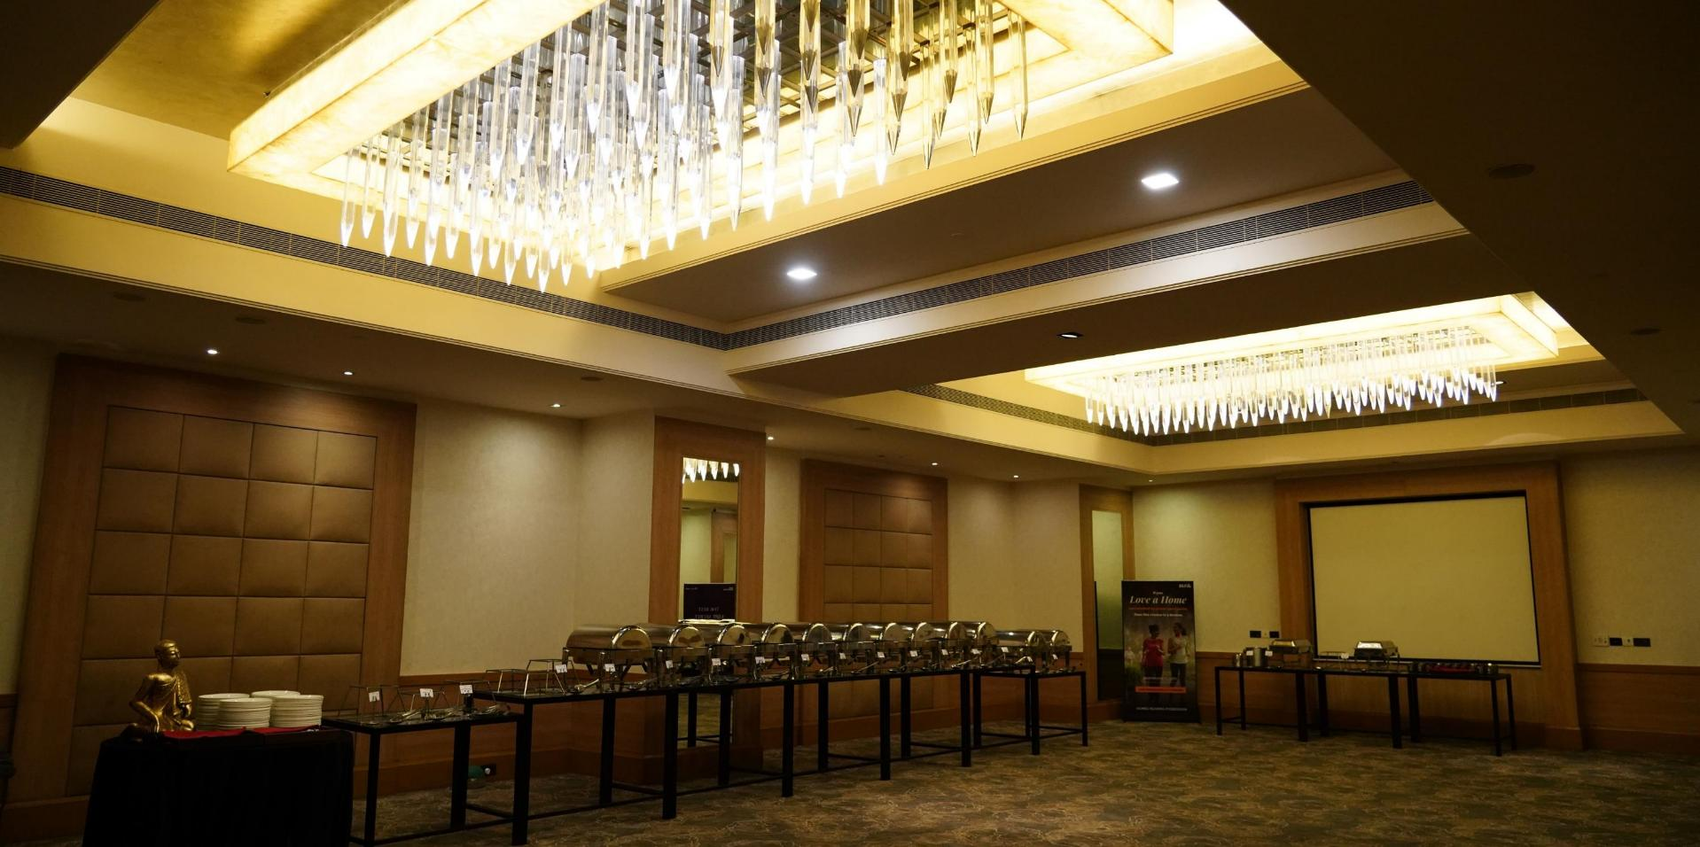
Current Financial Year Revenue 2025-26 (Till Date)
4 Cr.

Slide 6
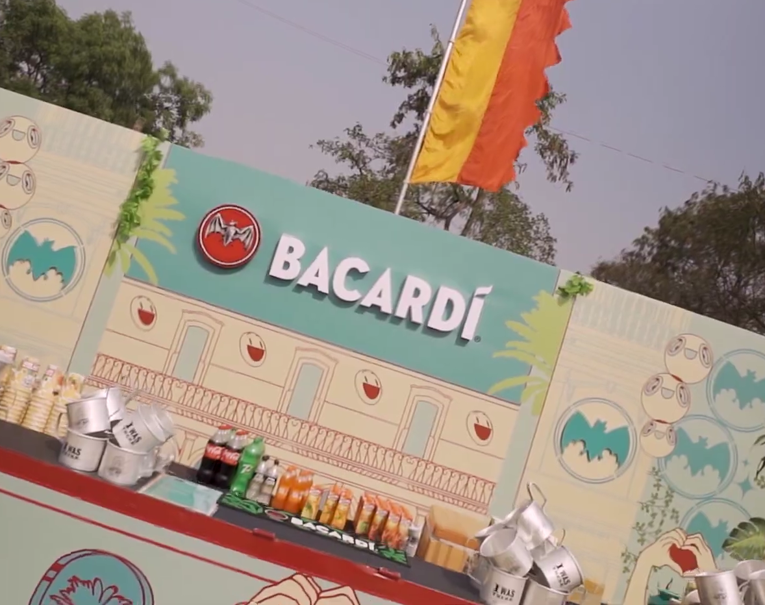
Let Us Show You Some Of Our Major Works

Slide 7
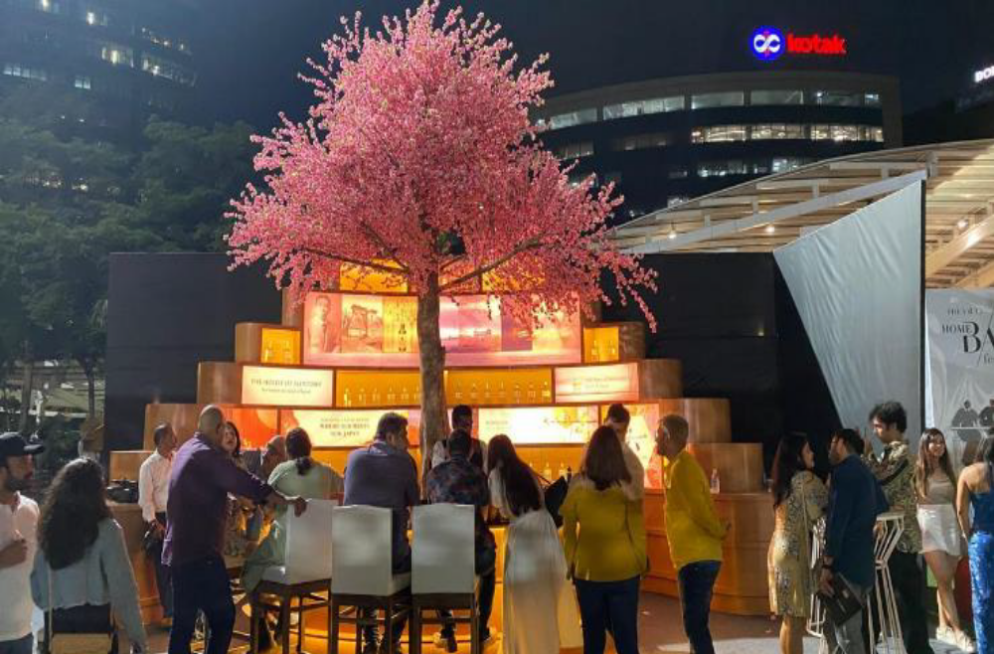
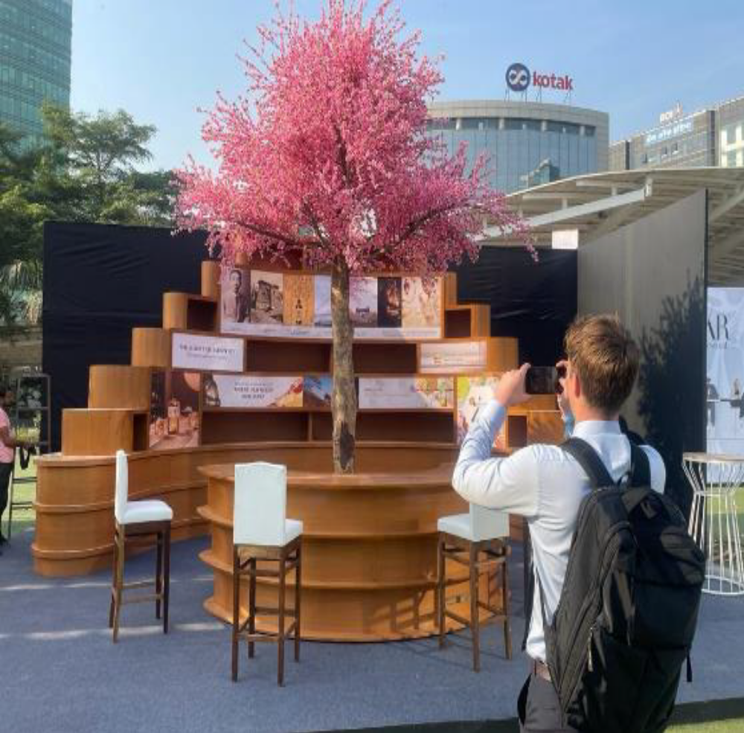
Bar Setups
Theme bar Inspired by Different Countries

Slide 8
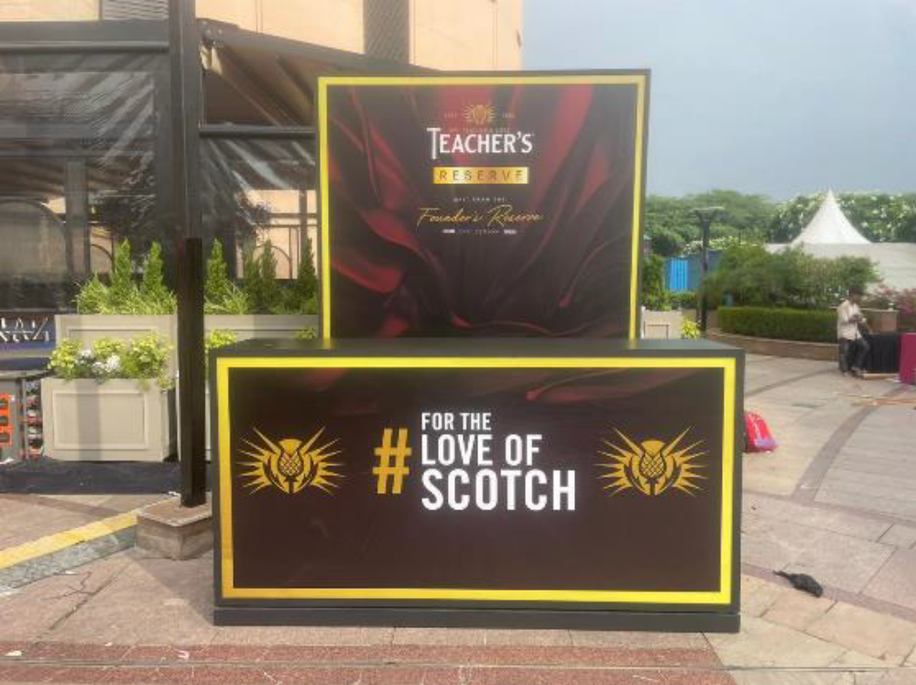
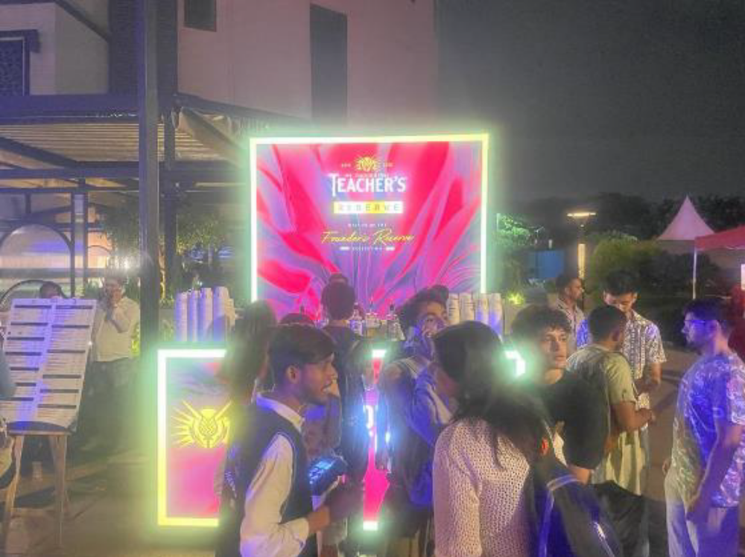
Bar Setups
Open Lit Bar for Corporate Event

Slide 9
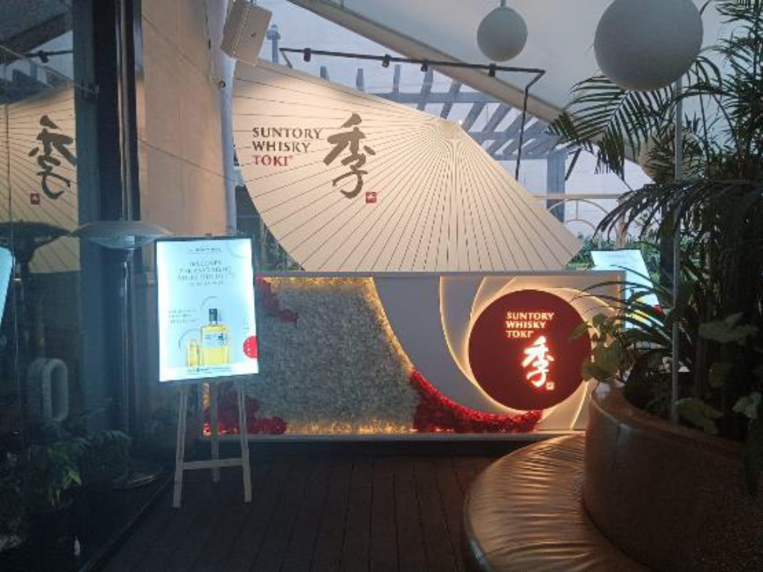
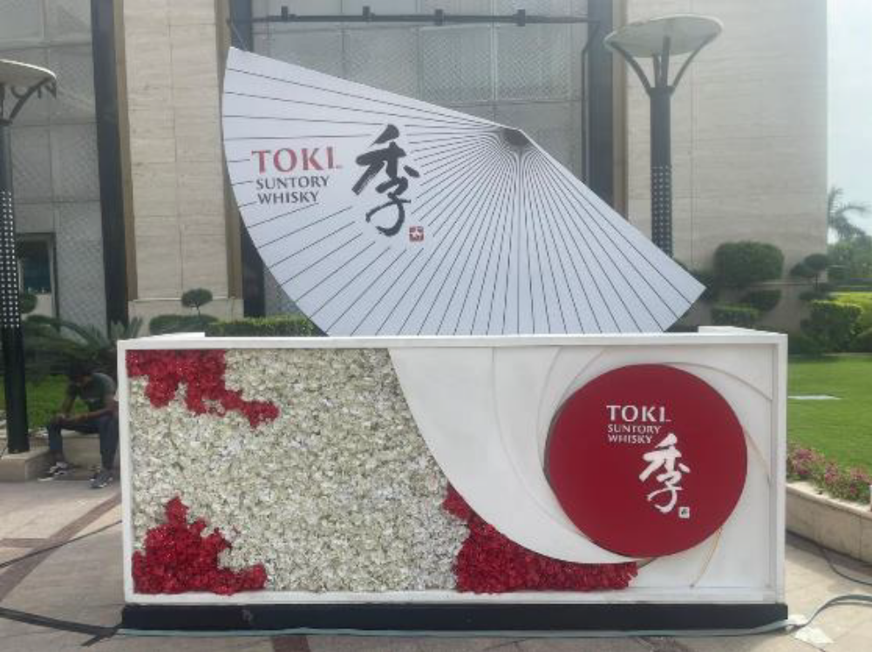
Bar Setups
Rooftop Bar for Beam Suntory

Slide 10
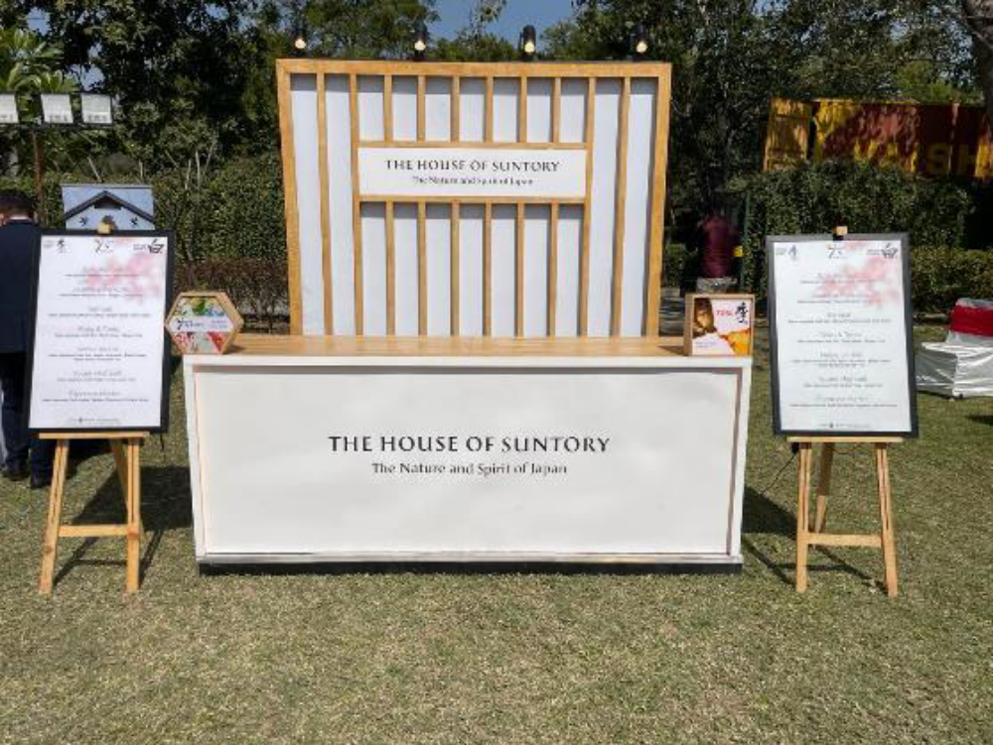
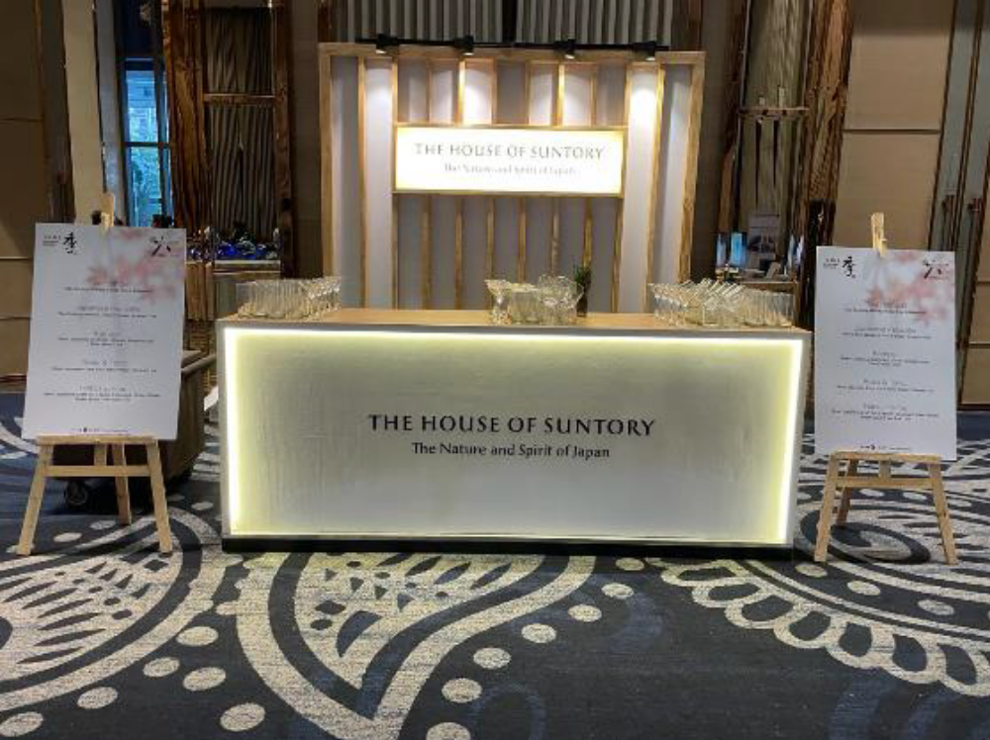
Bar Setups
Bar for Beam Suntory IN Corporate Event

Slide 11
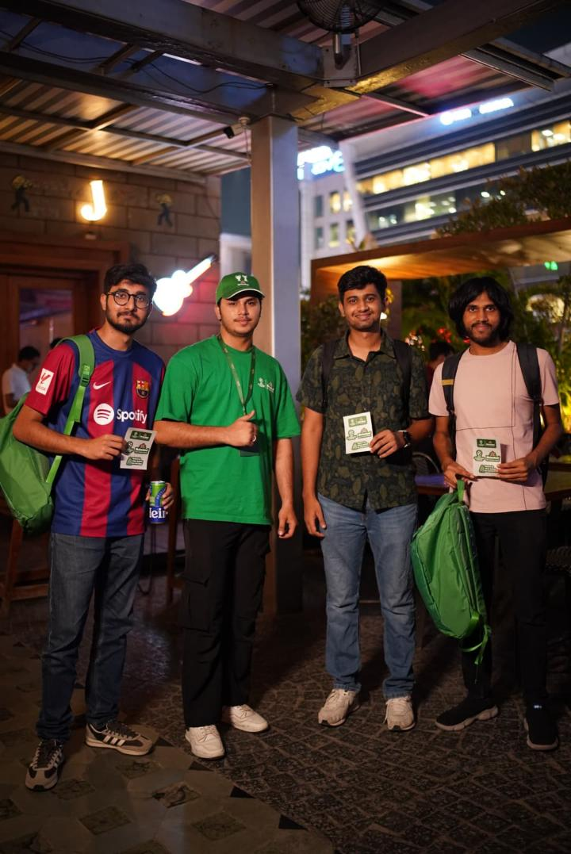
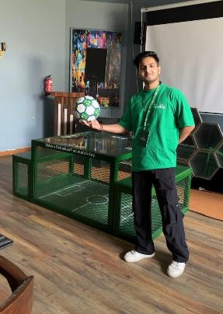
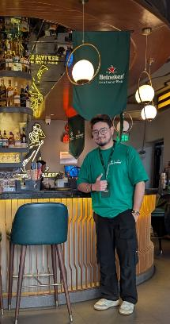
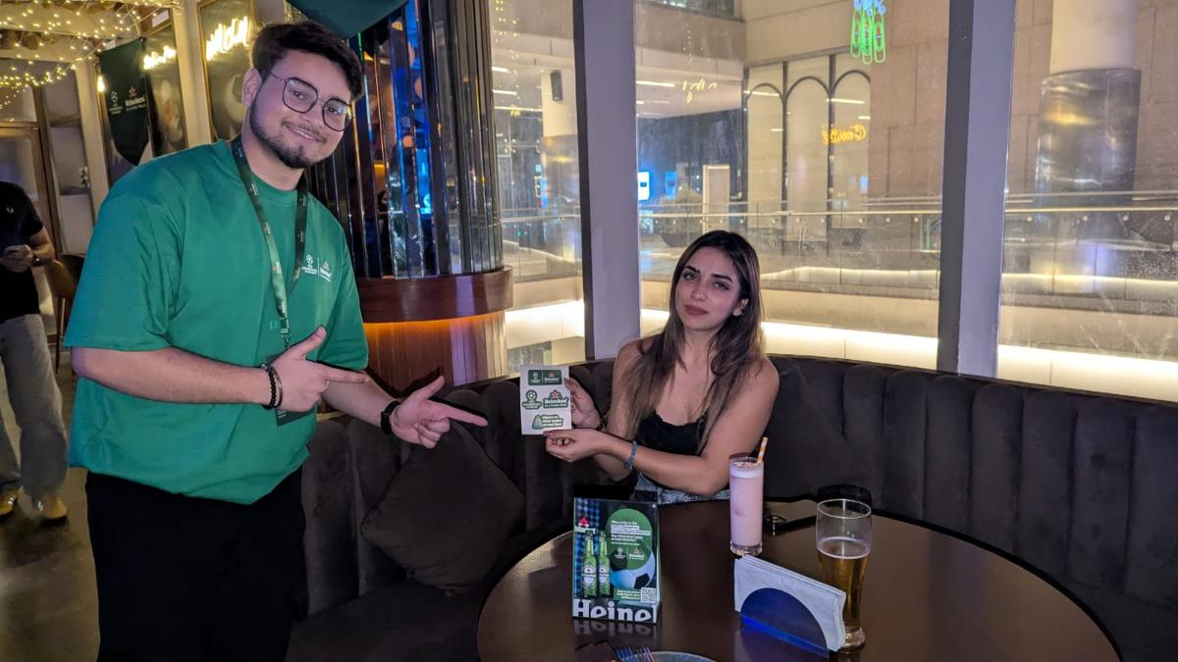
Manpower and Activation
Setup & Manpower for Various Companies In Clubs/Bars/Café/Cluster Markets/RWA Etc

Slide 12
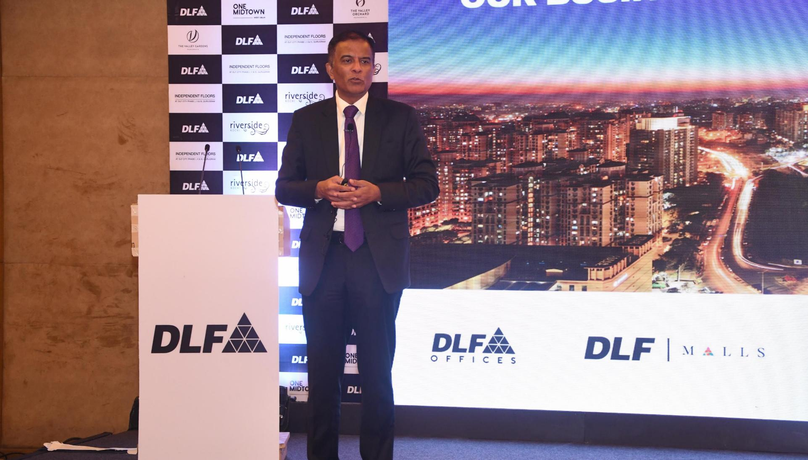
Corporate Event

Slide 13
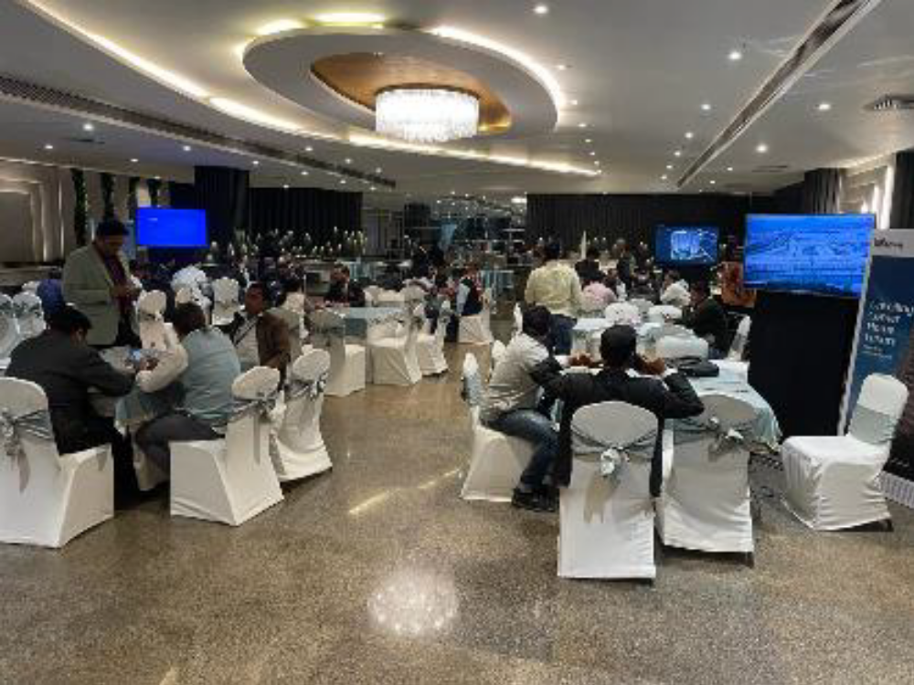
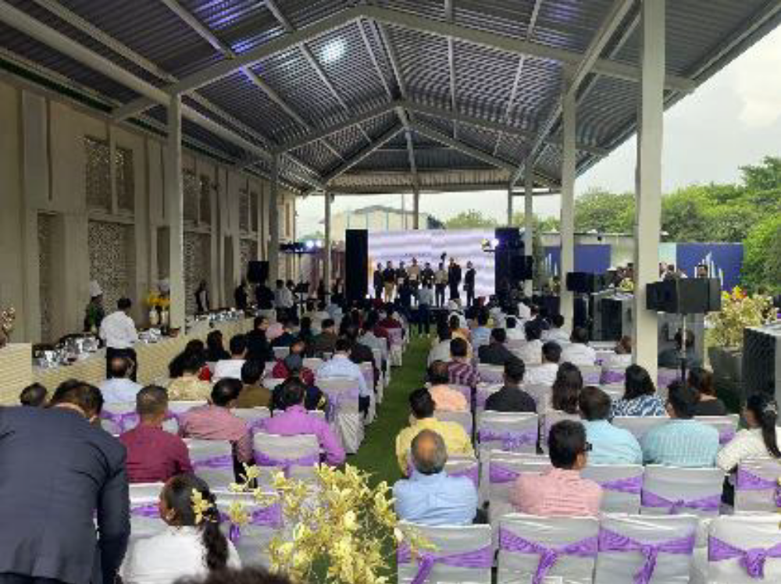
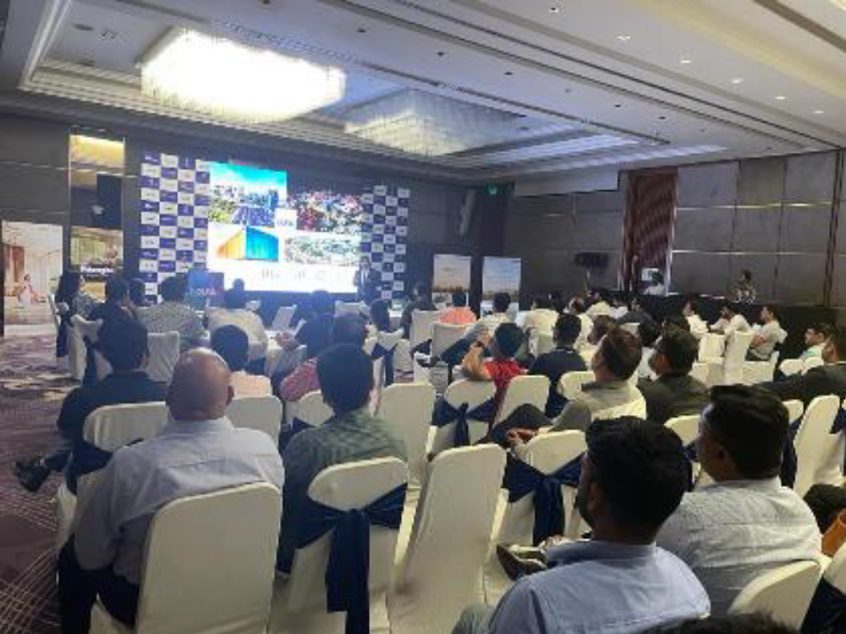
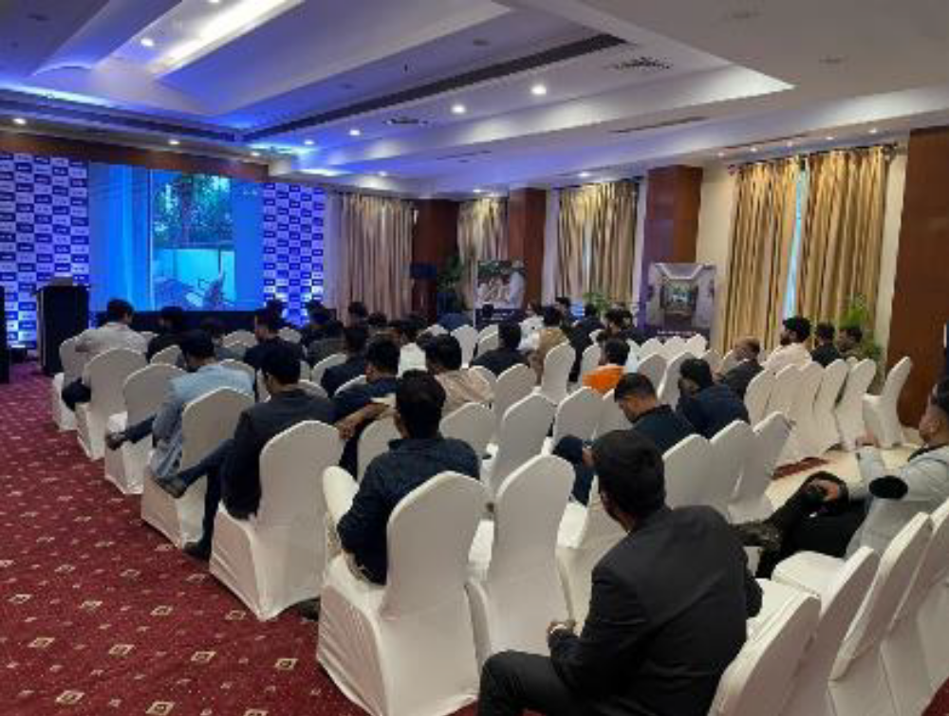
Dealers Meet/Annual Meet, Outreaches
Setup, 5 star Hotels Booking & Manpower for DLF Real estate – Pan India

Slide 14

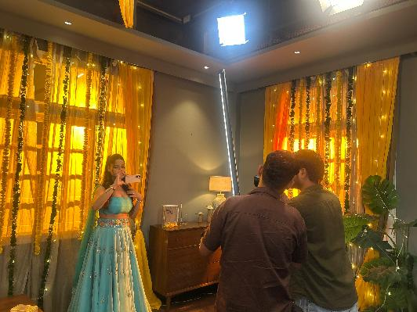

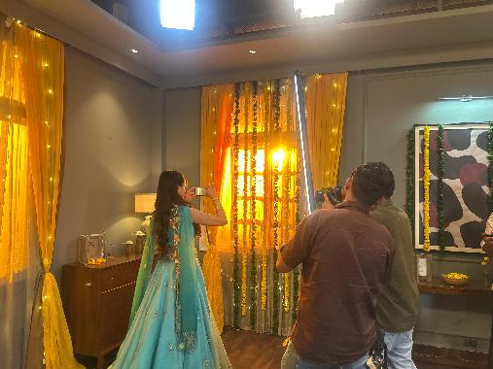
Video & Photo Shoot
Creating a premium and immersive experience for clients, partners and Artists Includes Studio Bookings, full management, personalized branding, and seamless coordination to ensure a smooth shoots.

Slide 15
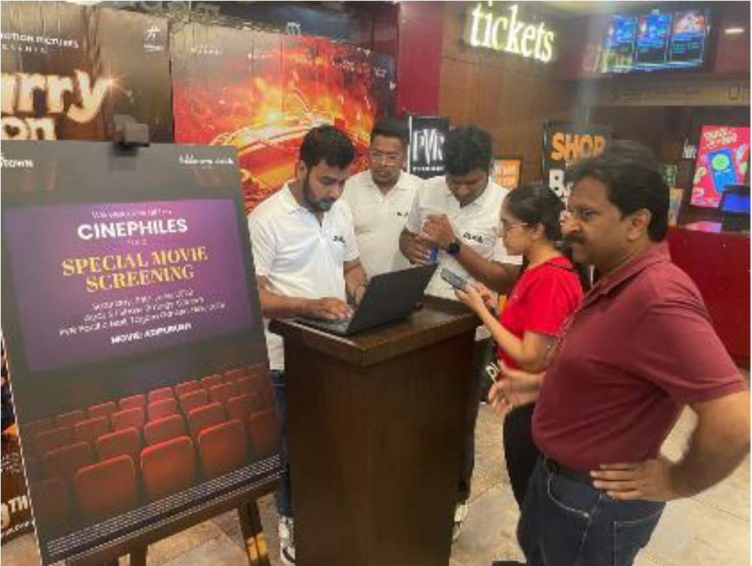
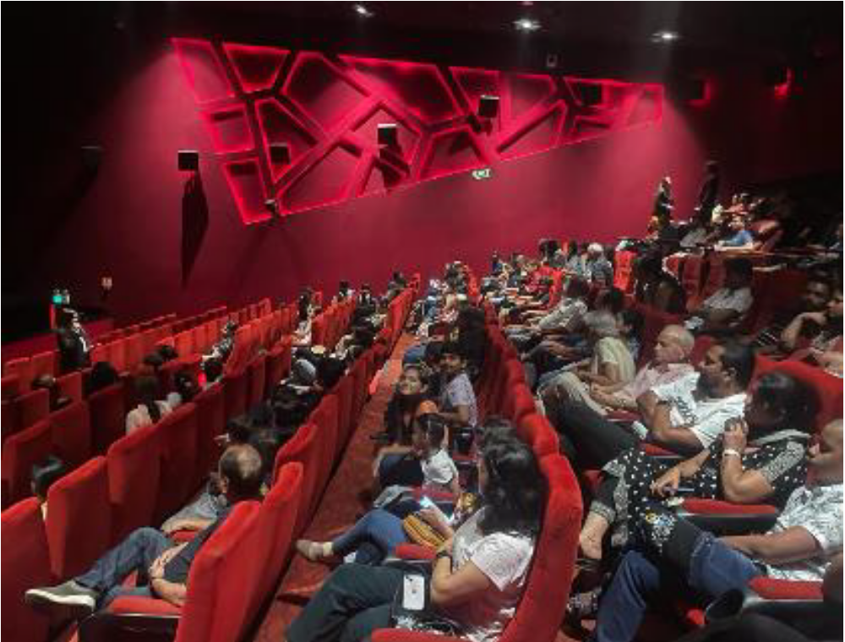
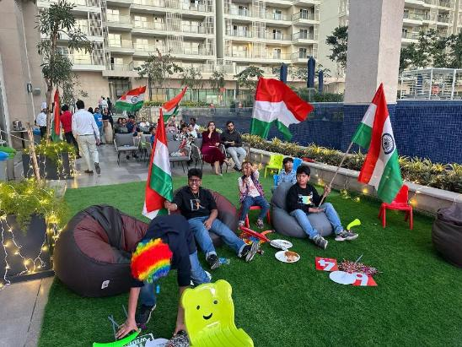
Theatre/Onsite Screenings
Live Screenings in cinemas and club houses, creating a premium and immersive entertainment experience for clients, partners, or employees. Includes full event management, personalized branding, and seamless coordination to ensure a memorable occasion.

Slide 16
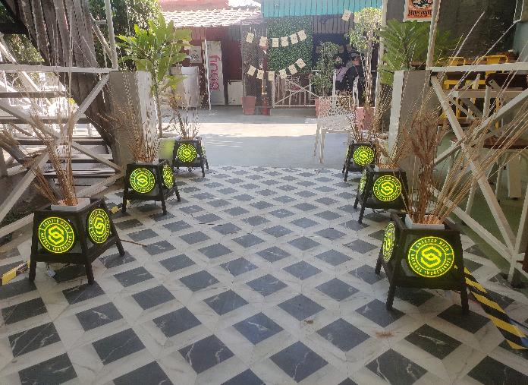
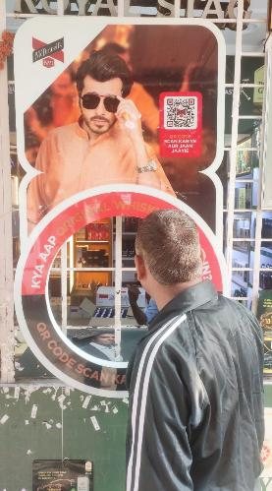
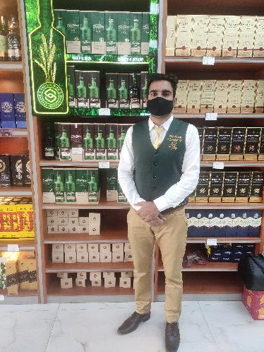
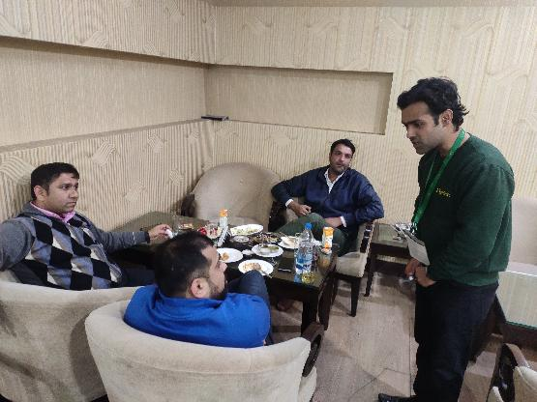
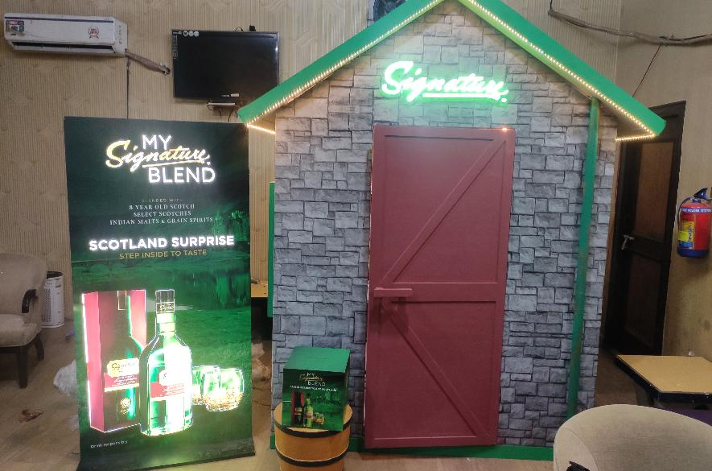
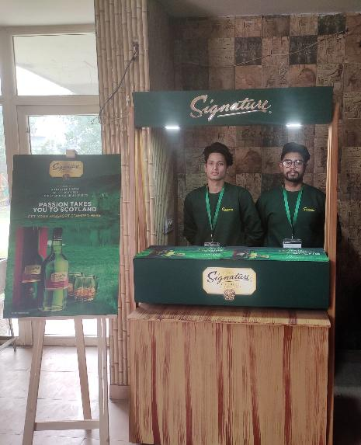
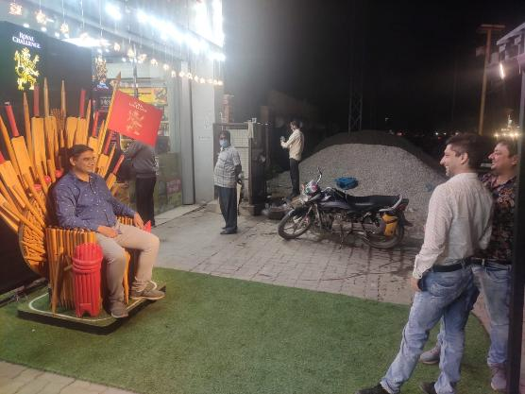
Activations
Clusters/Clubs/On Premises/Off Premises Activations for various companies for better visibility of the brands

Slide 17
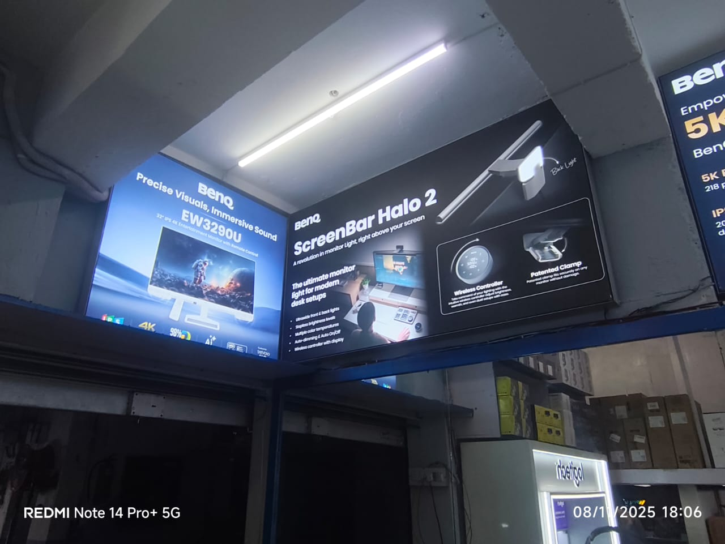
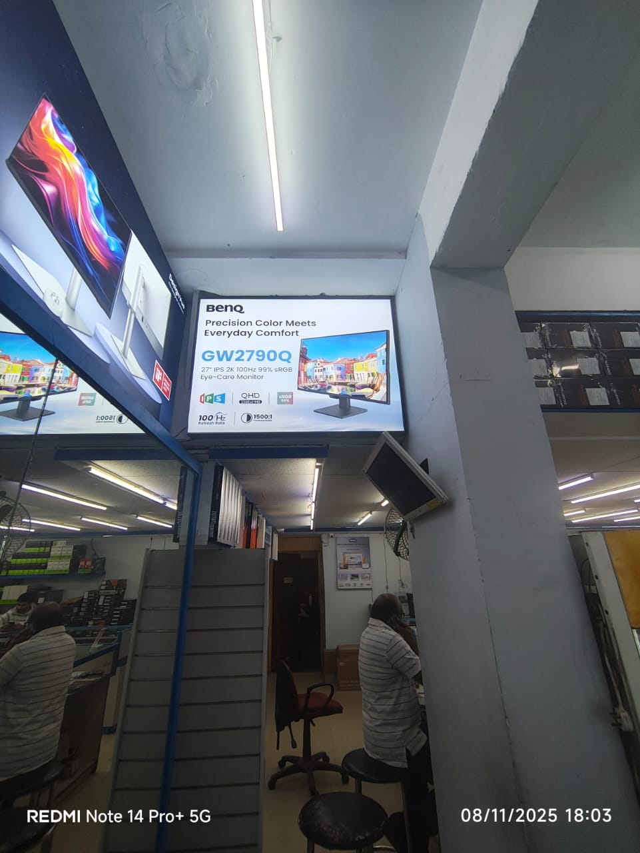
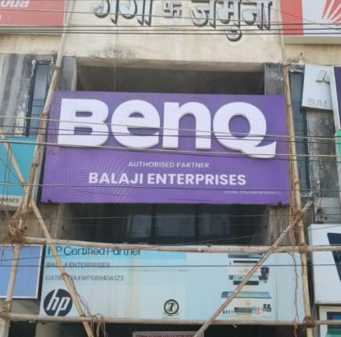
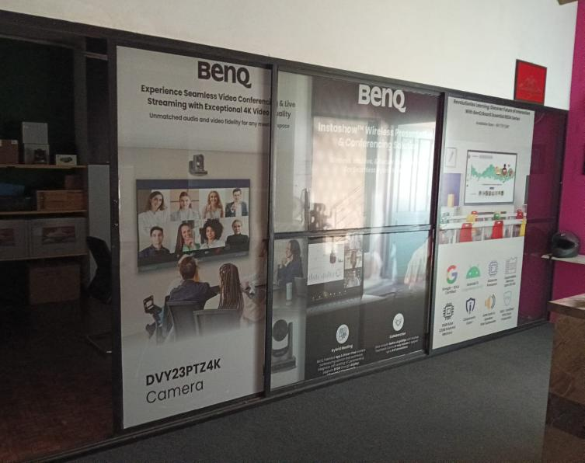
Retail Outlet/Shops Brandings
ACP, GSB, Clip On, Acrylic, Flex, Vinyl, Danglers works etc – Pan India

Slide 18
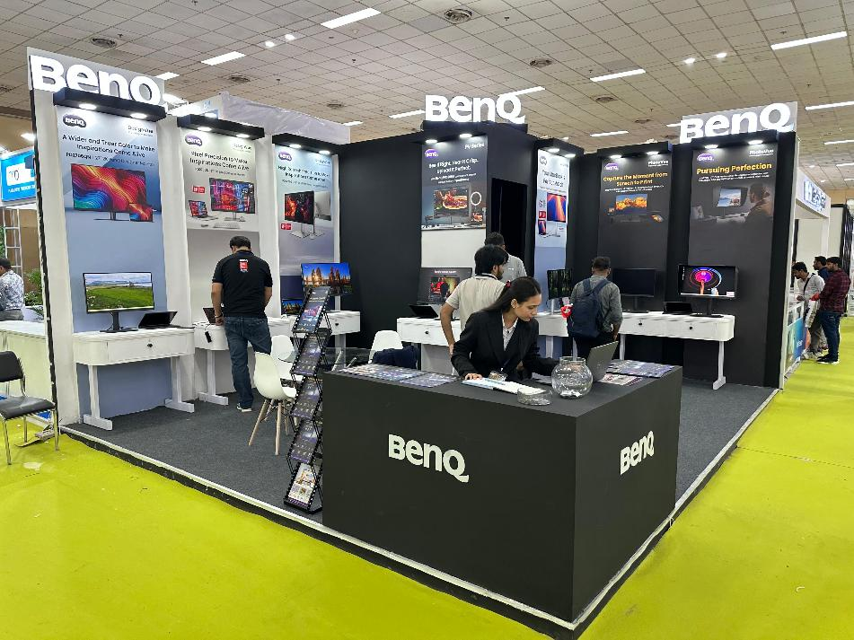
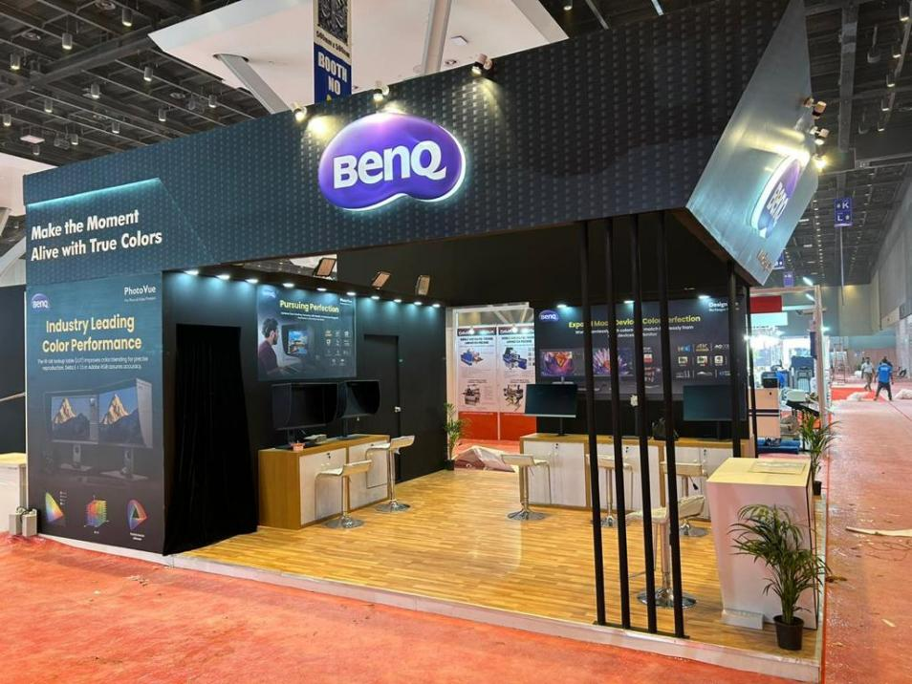
Stall Design and Fabrications
Stall Fabrications, Stall Branding – Pan India

Slide 19
Unlock New Responsibilities
Let’s Build Something Extraordinary

Slide 20





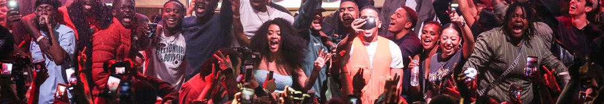
Contact us
We Are Waiting For You To Plan Your Event With Us
Let’s Plan Your Vision
Gaurav Sharma
Registered Address
Proprietor
1/6089, Top Floor, Street Number -2, East Rohtash Nagar, Shahdara, Delhi -110032
Call – +91 78385 40067
Email – gaurav@majesticmm.in
GST - 07CFWPS7475A1ZS
MSME - UDYAM-DL-07-0008758

